Slide 1
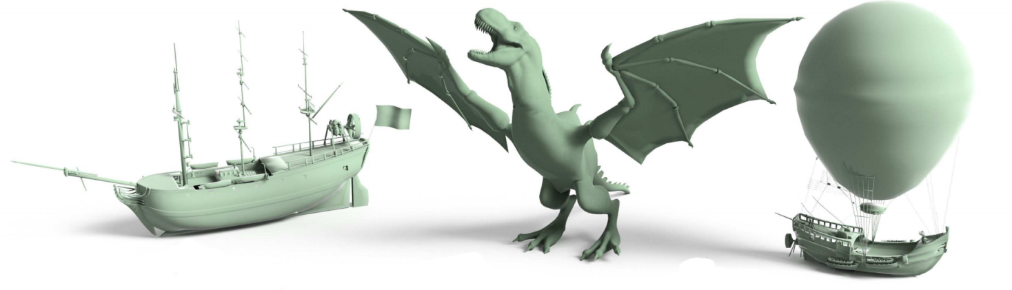
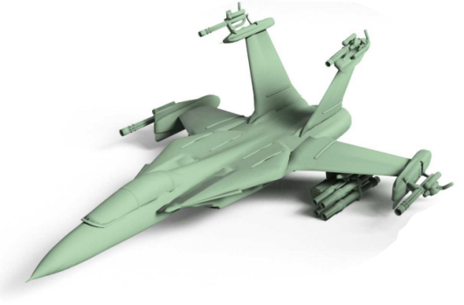
Probabilistic Reasoning for
Assembly-Based 3D Modeling
Siddhartha Chaudhuri, Evangelos Kalogerakis,
Leonidas Guibas, Vladlen Koltun
Stanford University
Notes:
[NEXT]

Slide 2
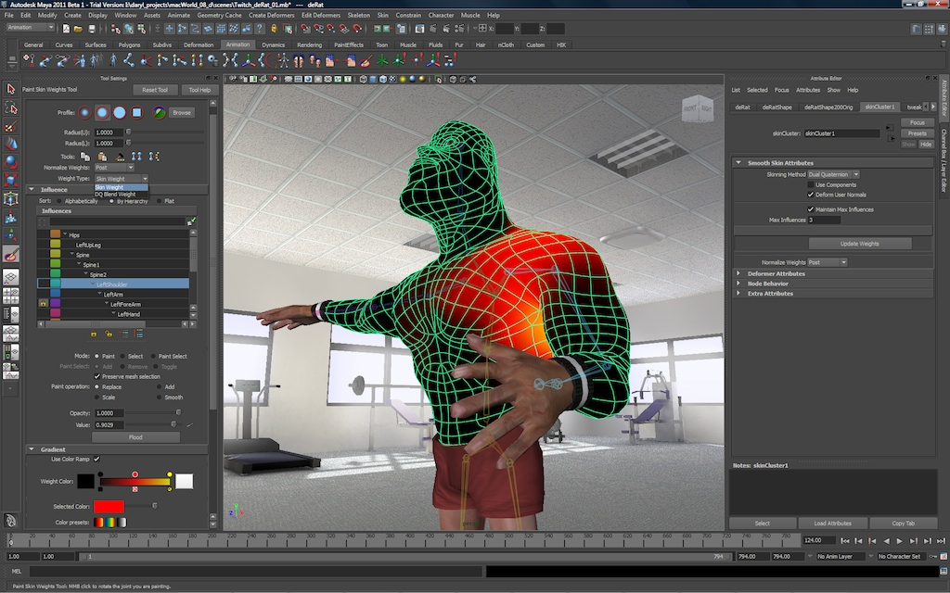
Creating detailed 3D content is hard
Notes:
Creating detailed 3D content is hard. The most popular 3D modeling tools, such as Maya and Max, require lots of technical and artistic expertise. Users need to be trained artists that are familiar with the low-level geometry processing operations and complex interfaces, as you see here. [NEXT]

Slide 3
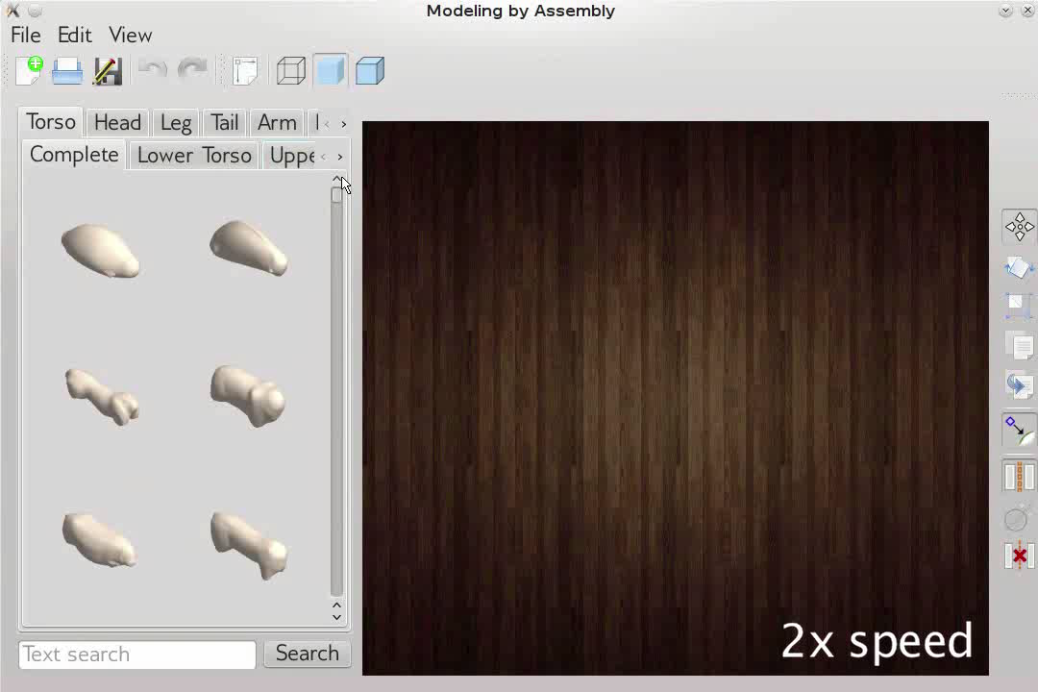
Notes:
We developed a tool that allows even novice users to assemble original, detailed 3D models by putting together components extracted from shape repositories. Here is a screenshot of our tool. On the left, components are presented to the user, such as torsos, heads, legs and so on. The user can select some of these parts and put them together to create a new shape.
Now, a problem is that there may be many thousands or millions of such components available to the user. If we presented the components as a static list, it would be tedious for users to manually browse the list and find the ones they want. Furthermore, for complex assemblies, the user may not always know what components are necessary to create a plausible shape. Therefore, it is helpful if the tool understands the structure of shapes and automatically suggests components that the user might want to use next. And that’s exactly what our tool does. [CLICK]
I show here a video capture from a representative modeling session with our tool. On the left, components are organized hierarchically into tabs based on their semantic categories. Shapes are assembled via drag-and-drop. As soon as a component is added, the order of suggested categories and that of components within them is updated interactively to reflect their compatibility with the current shape. [NEXT]

Slide 4
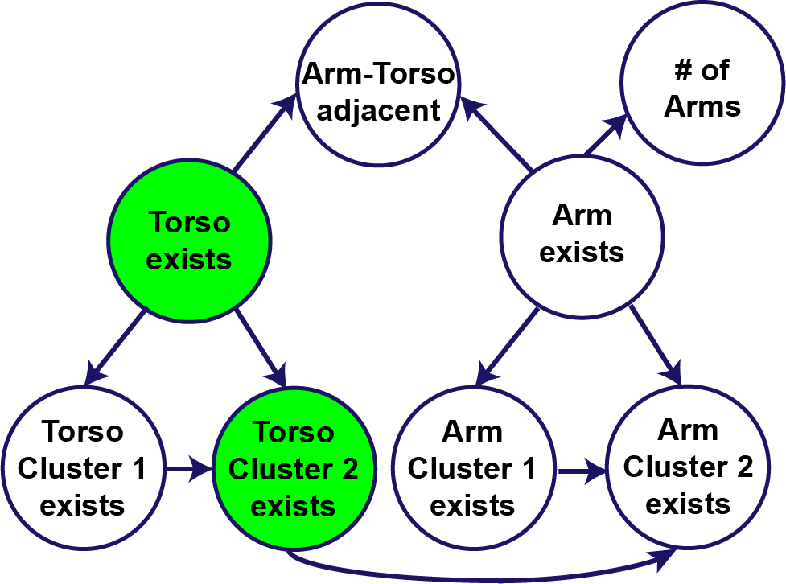
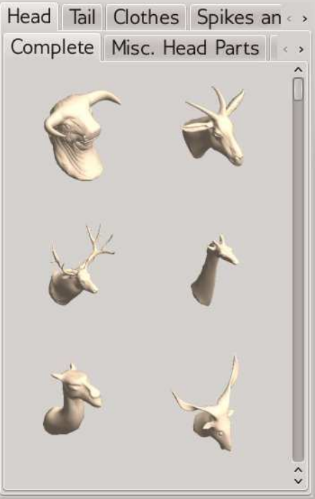
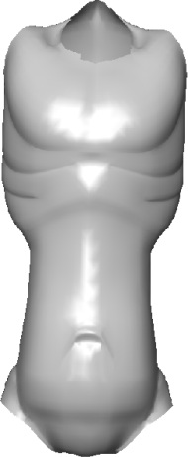
Probabilistic model for presenting relevant components
Observed
data
Inference
Current
shape
Probabilistic model
Ranked components
Notes:
How can we preset the most relevant components for the user’s current shape? I will describe a probabilistic reasoning approach that achieves this.
Given an incomplete shape currently modeled by a user, our method performs inference in a probabilistic model [CLICK] that encodes semantic and geometric relationships among the shape components of the input repository. [CLICK] Based on the results of the inference, our method generates ranked lists of category labels and components within each category that are presented to the user interactively through our user interface. [NEXT]

Slide 5
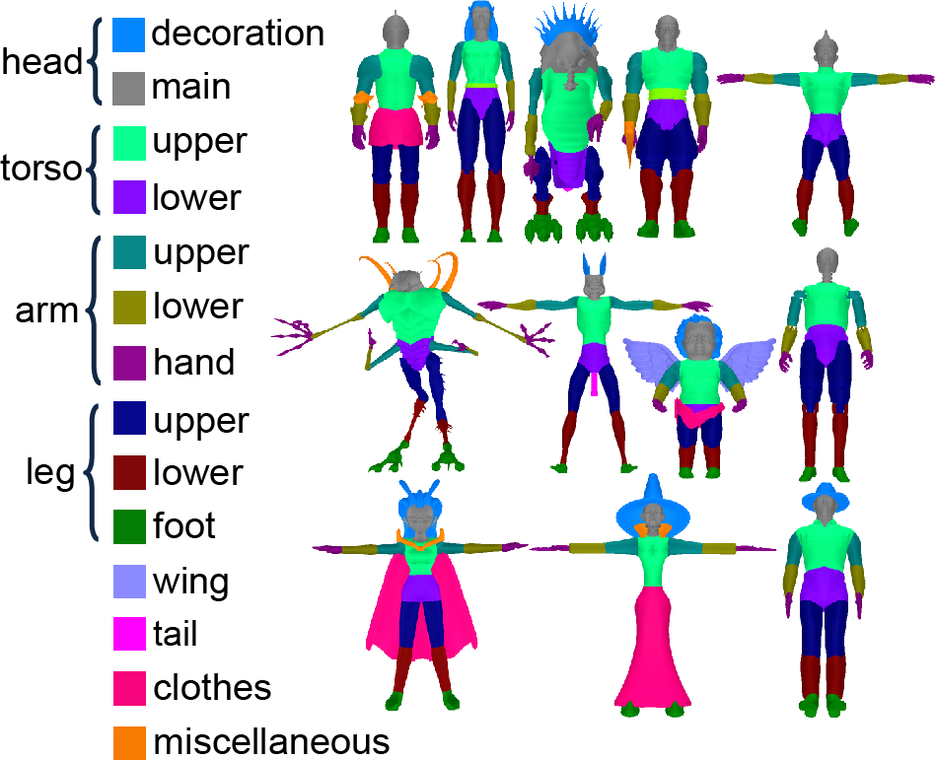
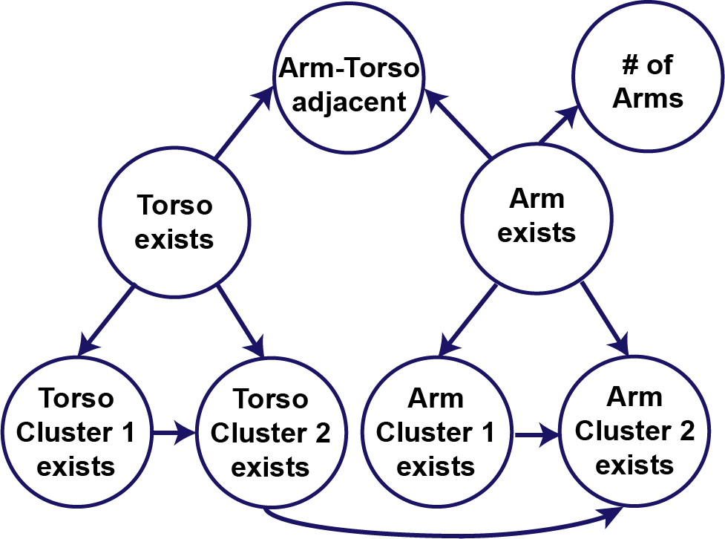
The model is learned from an input shape repository
Learning
Input repository
Probabilistic model
Notes:
The probabilistic model is learned from the input repository of shapes. The repository shapes are segmented and their components are labeled according to a given set of labels, as you see on the left. [CLICK] Based on this data, the parameters as well as the structure of the probabilistic model are learned automatically. [NEXT]

Slide 6
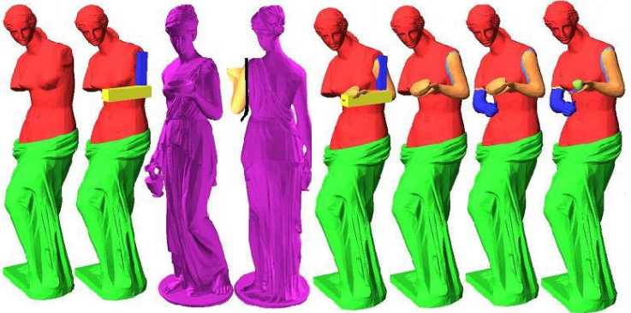
Related work: assembly-based 3D modeling
Modeling by example [Funkhouser et al. 2004]
Notes:
Assembly-based 3D modeling has been the focus of previous research projects. It was initially pioneered by Funkhouser and collaborators in 2004. In their Modeling by Example system, users retrieve source 3D models using text- or shape-based search. The users segment components manually from the retrieved library models [NEXT]

Slide 7
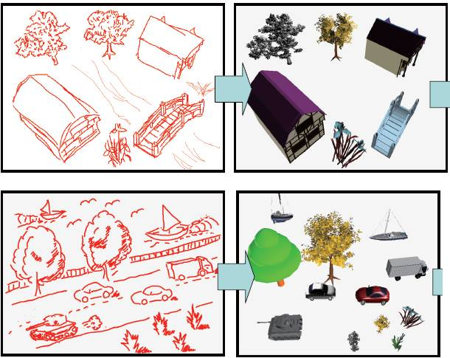
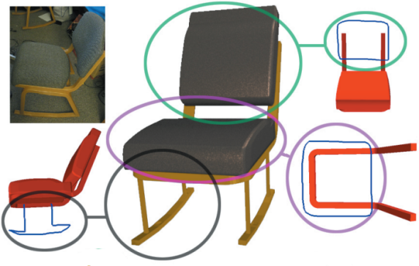
Related work: assembly-based 3D modeling
Sketch-based retrieval of components
[Shin and Igarashi 2007] & [Lee and Funkhouser 2008]
Notes:
Subsequent research has also investigated sketch-based retrieval of components [NEXT]

Slide 8
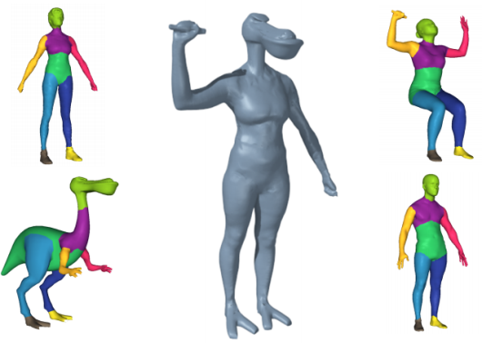
Related work: assembly-based 3D modeling
Model Composition from Interchangeable Components
[Kraevoy et al. 2007]
Notes:
The shuffler system allowed users to interchange components between a set of automatically segmented shapes. [NEXT]

Slide 9
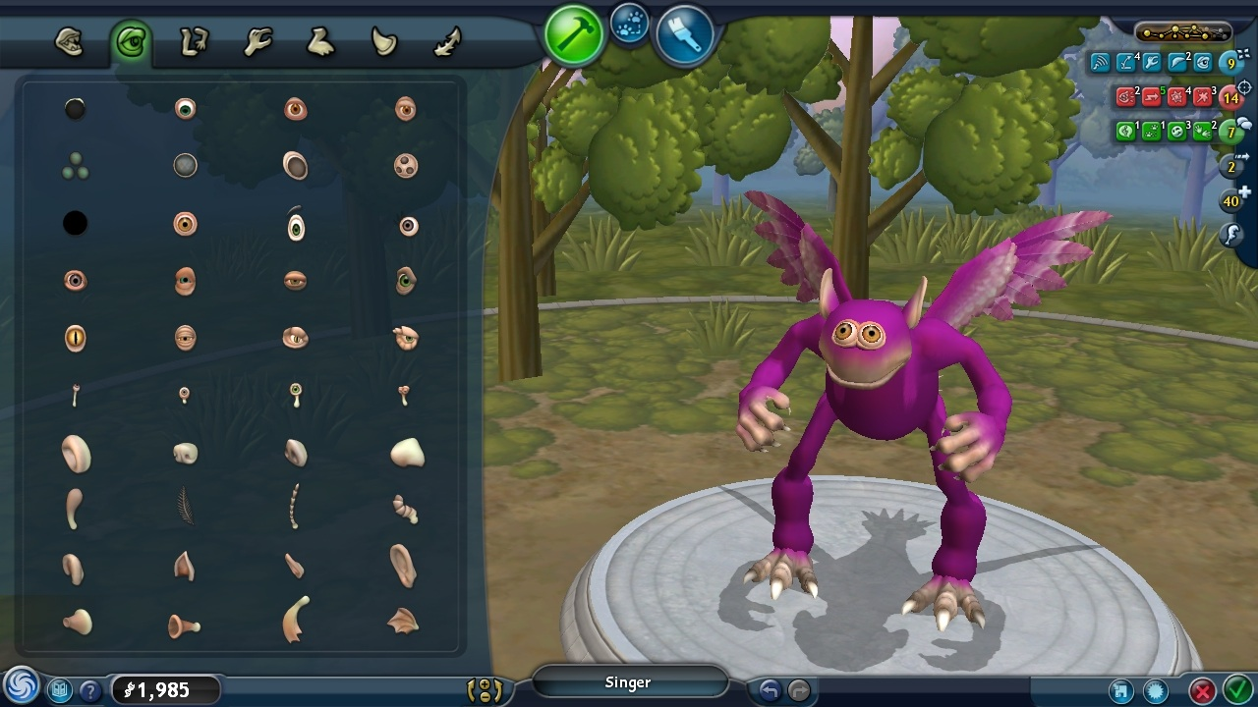
Related work: Spore [Maxis Software 2008]
Notes:
The interface of our assembly-based modeling tool is inspired by the Spore creature creator, which allows creatures to be assembled from components such as heads, legs, arms and so on. The Spore creature creator has been used to create over one hundred million creature shapes in the ﬁrst year after release. In Spore, the components are manually crafted. Also I’d like to emphasize that the order they appear to the user is pre-specified and static. As new parts are added to the creature, the list of presented components you see on the left remains the same [NEXT]

Slide 10
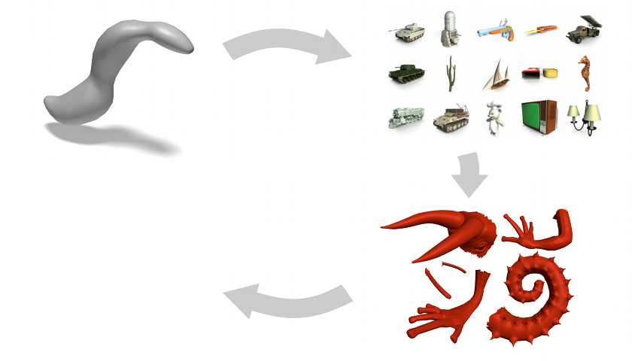
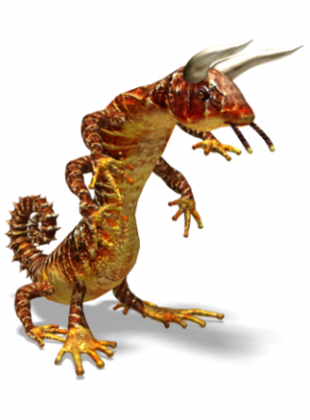
Related work: Data-driven suggestions
Creativity support in 3D modeling [Chaudhuri and Koltun 2010]
Notes:
Our work is mostly related to the technique of Chaudhuri and Koltun from the previous Siggraph ASIA. That technique introduced data-driven suggestions for creativity support in open-ended 3D modeling environments. [NEXT]

Slide 11
Related work: Data-driven suggestions
Creativity support in 3D modeling [Chaudhuri and Koltun 2010]
Notes:
More specifically, given an initial shape [NEXT]

Slide 12
Related work: Data-driven suggestions
Creativity support in 3D modeling [Chaudhuri and Koltun 2010]
Notes:
…the technique retrieves shapes from an input repository that can be used as sources of suggestions. [NEXT]

Slide 13
Related work: Data-driven suggestions
Creativity support in 3D modeling [Chaudhuri and Koltun 2010]
Notes:
For each retrieved library shape, the technique identiﬁes components that are not present in the user’s current shape and presents them in a ranked list. [NEXT]

Slide 14
Related work: Data-driven suggestions
Creativity support in 3D modeling [Chaudhuri and Koltun 2010]
Notes:
The user selects some of these components to augment the initial shape and create a novel one. [NEXT]

Slide 15
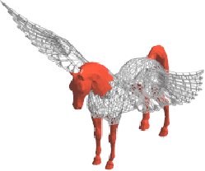

Should suggestions be agnostic to the structure of shapes being modeled?
Notes:
An interesting question here is whether the suggestions of components should be agnostic to the structure of shapes being modeled. In such open-ended modeling scenarios, the user does not necessarily know a priori what shape he wants to assemble exactly. On the other hand, he usually has some knowledge about the semantic structure of shape he wants to create. Previous techniques do not take into account any prior knowledge about the shapes being assembled; they are purely geometric. As a result, the techniques might end up suggesting components that are not relevant to the structure of shape that the user wants to create. For example, here’s is an example from the approach by [Chaudhuri and Koltun]; it can suggest a horse head or horse legs for augmenting the aircraft on the left.
In contrast to previous approaches, our probabilistic model suggests components that are geometrically and semantically compatible with the shape being assembled. [NEXT]

Slide 16
Our probabilistic model
Represents both semantic and geometric relationships
Learned automatically from a shape database
Interactive suggestions of components
Increases relevance of presented components
Notes:
This is because our model takes into account both the semantic and geometric relationships to infer the relevance of components [CLICK]. The model is learned automatically from a large input repository of shapes. [CLICK] The components are suggested to the user interactively and updated dynamically as he assembles the shape. [CLICK] Based on our experiments, we found that our probabilistic model increases the relevance of presented components to the users significantly [NEXT].

Slide 17
Outline
Probabilistic model definition
Learning
Inference
Results
Notes:
First, let’s define what our probabilistic model is.

Slide 18
Our probabilistic model: a Bayesian Network
Shape attributes
Dependencies
between attributes
Random variables
Represent with DAG
x₁
x₂
x₃
Notes:
In our probabilistic model, shape attributes are represented as random variables, say X. Therefore, each shape is treated as a sample from a joint probability distribution P(X) over these random variables. [CLICK] We also have dependencies between the shape attributes. For example if four legs exist, then a tail probably exists. To capture these dependencies compactly, [CLICK] the probability distribution is represented as a product of factors with small number of parameters. (The factors are either prior distributions for each random variable that does not depend on others or conditional probability distributions for each random variable that depends on others; these are called its parents.) These dependencies can be represented with a directed acyclic graph, as you see below. These probabilistic models are also known as Bayesian Networks. [NEXT]

Slide 19
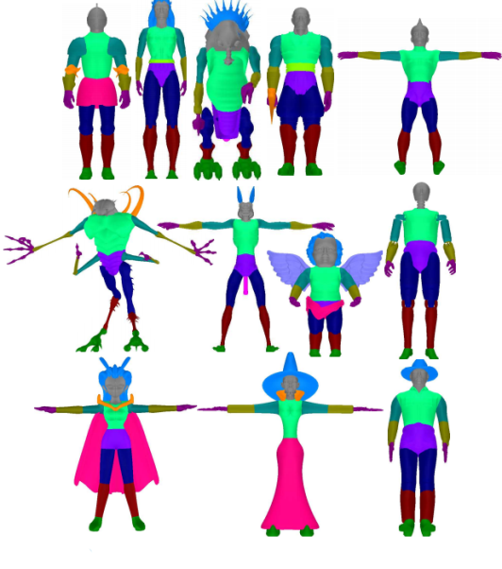
Random variables E_{l}
Existence of component from category l
Arm(s)
exist
Torso(s) exist
Notes:
I will go now into more detail about the random variables and parameters we have in the probabilistic model. First we have random variables representing whether a component from a category exists in a shape. There is one such random variable for each category. [CLICK] For example, let’s consider a case where we have a repository of creatures. Therefore, we have random variables expressing the existence of torso, arm, leg and so on. Here I show the existence random variables just for torso and arm for didactic reasons. [NEXT]

Slide 20
Random variables N_{l}
Number of components from category l
Arm(s)
exist
# of Arms
Torso(s) exist
Notes:
Then we have random variables representing the number of components from each category. We use these random variables along with the existence random variables in our model, since certain dependencies of components are more compactly expressed in terms of their existence rather than their exact cardinality. [NEXT]

Slide 21
Random variables A_{l,l’}
Adjacency between components from categories l and l’
Arm(s)
exist
# of Arms
Arm-Torso adjacency
Torso(s) exist
Notes:
Then we have random variables representing whether a component from one category l is adjacent to another component from a different category l’. There is one such variable for each distinct pair of category labels. To prune the number of variables, we omit adjacencies that never appear in the repository. [NEXT]

Slide 22
Random variables R_{l,l’}
Symmetry relation between components from categories l and l’
Arm(s)
exist
# of Arms
Arm-Torso adjacency
Arm-Torso symmetry
Torso(s) exist
Notes:
We also have variables that represent whether a component has a symmetric counterpart. For examples, arms are reflected in the torso. Hence, we have a variable that expresses this relationship. There is one such variable for each such symmetry relationship between two categories that exists in the repository. [NEXT]

Slide 23
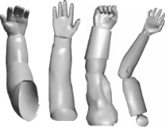
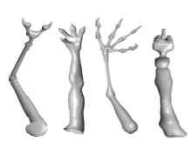
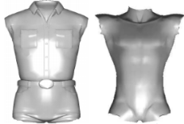
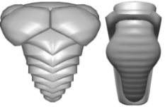
Random variables S_{s,l}
Existence of component from style cluster s of category l
Arm style 1 exists
Arm(s)
exist
# of Arms
Arm style 2
exists
Arm-Torso adjacency
Torso style 1
exists
Arm-Torso symmetry
Torso(s) exist
Torso style 2
exists
Notes:
Finally, we have random variables that represent whether a component of a particular geometric style exists in a shape. By geometric style, we mean a group of geometrically similar components. For example, a geometric style of arms includes fat arms, such as humanoid arms [CLICK]. A different arm style includes elongated, thin arms like alien arms [CLICK]. Similarly for torsos, [CLICK] there is a style for humanoid torsos and another one for alien torsos. [NEXT]

Slide 24


Dependencies between random variables
Arm style 1 exists
Arm(s)
exist
# of Arms
Arm style 2
exists
Arm-Torso adjacency
Torso style 1
exists
Arm-Torso symmetry
Torso(s) exist
Torso style 2
exists
Notes:
There are also conditional dependencies between all these random variables. As I mentioned, these dependencies are expressed with directed edges. For example, the number of arms depend on whether a particular style of arms can exist in the shape. [NEXT]

Slide 25
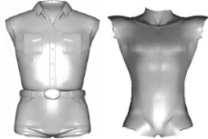
Conditional probability tables
R_{l}
1
N_{l}
0
2
1.0
0.7
Arm style 1 exists
Arm(s)
exist
# of Arms
4
0.0
0.3
Arm style 2
exists
Arm-Torso adjacency
Torso style 1
exists
Arm-Torso symmetry
Torso(s) exist
Torso style 2
exists
Notes:
Each dependent random variable is associated with a conditional probability distribution. In our model, the conditional probability distributions are express as conditional probability tables. The conditional probability table expresses the probability for each value of this random variable given the set of values for its parent random variables. For example, here, [CLICK] given that alien of arms exist, the probability of having fours arms is increased from 0.0 to 0.3, [CLICK] while the probability of having two arms is decreased from 1.0 to 0.7. [NEXT]

Slide 26
Dependencies between random variables
Arm style 1 exists
Arm(s)
exist
# of Arms
Arm style 2
exists
Arm-Torso adjacency
Torso style 1
exists
Arm-Torso symmetry
Torso(s) exist
Torso style 2
exists
Notes:
Obviously, there are many other dependencies between these random variables in this example [NEXT]

Slide 27
Outline
Probabilistic model definition
Learning
Inference
Results
Notes:
All the Conditional Probability Table entries as well as the graph structure in our model are learned automatically from the input library of shapes during the preprocessing stage. [NEXT]

Slide 28
Learning the CPTs and the graph structure
[Kalogerakis et al. 2010]
(modified)
Notes:
Here we assume that a subset of the repository shapes are manually segmented and their segments are labeled. The segmentations are propagated to the rest of the input library shapes based on a modified version of the learning algorithm by Kalogerakis et al. from Siggraph 2010. [NEXT]

Slide 29
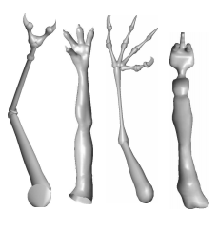
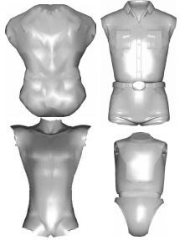
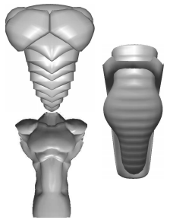
Learning the CPTs and the graph structure
Arm
cluster 1
Arm
cluster 2
[Kalogerakis et al. 2010]
(modified)
Torso
cluster 1
Torso
cluster 2
Notes:
Given the segmented and labeled shapes of the repository, the method performs clustering to identify groups of geometrically similar components within each component category. [NEXT]

Slide 30
Learning the CPTs and the graph structure
Arm
cluster 1
Arm
cluster 2
[Kalogerakis et al. 2010]
(modified)
Torso
cluster 1
Torso
cluster 2
Notes:
Given the segmented dataset and the extracted clusters of components, the method learns the structure and parameters of the Bayesian network. [NEXT]

Slide 31
Structure and parameter learning
Maximize Bayesian Information Criterion
Notes:
The learning procedure aims at maximizing the Bayesian Information Criterion score. [CLICK] To maximize the score, we use a local search heuristic that explores the space of network structures by adding, removing, and ﬂipping edges. The score consists of two terms. [NEXT]

Slide 32
Structure and parameter learning
Maximize Bayesian Information Criterion
Likelihood term
D: training data
G: graph structure
θ: CPT entries
Notes:
The ﬁrst term is the likelihood of the parameters theta of the model for our training data D given a structure G of the network selected by the heuristic. [NEXT]

Slide 33
Structure and parameter learning
Maximize Bayesian Information Criterion
Penalize model complexity
v: # of independent CPT entries
n: # of training shapes
Notes:
The second term penalizes the model complexity: the more edges we have in the network, the larger the number of conditional probability table entries, therefore the penalty term is increased. This prevents our model from over-fitting the training data. [NEXT]

Slide 34
Outline
Probabilistic model definition
Learning
Inference
Results
Notes:
The learned model can now be used to infer relevant components during interactive modeling sessions. [NEXT]

Slide 35

Inference
Notes:
Given a shape currently modeled by the user, [NEXT]

Slide 36
Inference
Evidence
X_{e}= e
Notes:
a set of random variables in our Bayesian network become observed. For example, the random variable for the existence of torso and torso-alien style in the shape are set to true. The rest of the random variables are unobserved. [NEXT]

Slide 37

Inference
Evidence
X_{e}= e
P( | X_{e} = e) ?
Notes:
Given the evidence from the observed data, we want to find the probability of including each library component to the current shape. The compatibility of a component is evaluated based on how likely its category label is to be adjacent to any of the category labels existing in the shape, how likely the shape is to include more components of its category, and how likely the shape is to include components of its style. [NEXT]

Slide 38
Inference
Evidence
X_{e}= e
P( X_{q} = q | X_{e} = e )
Particle-based inference
Notes:
This compatibility is measured by querying the corresponding random variables representing this information. To evaluate these queries for each component in the database, we used a fast particle-based inference technique. The result of the inference procedure is the ranked list of category labels and components within each category that are presented to the user with the interface of our tool.

Slide 39
Outline
Probabilistic model definition
Learning
Inference
Results
Notes:
I’ll proceed now with our results and experiments to evaluate the relevance of the presented components of our method.

Slide 40
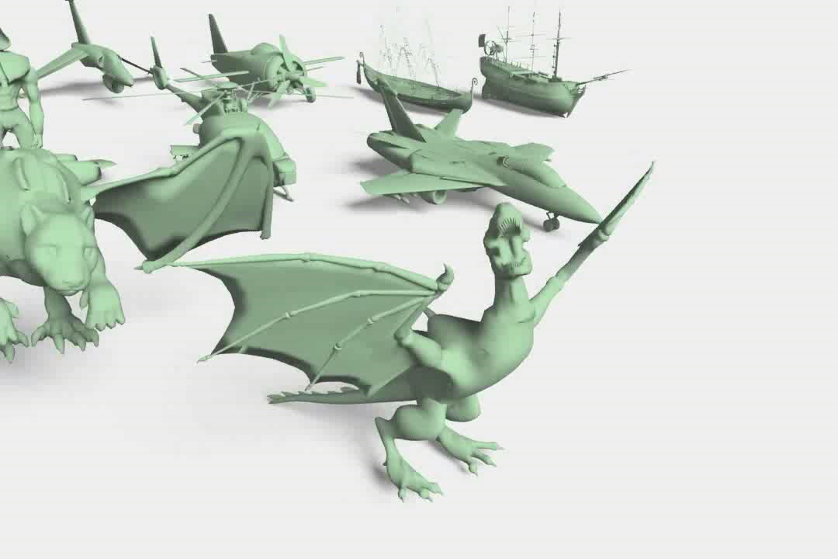
Examples of shapes created by users
Notes:
[CLICK!!!!] Here I show a video presenting the shapes created by the users with the assembly-based 3D modeling interface in the probabilistic model condition. Most of the participants had little or no prior exposure to 3D modeling. On average, the participants used 10 components per 3D shape. The components used in single assembled 3D model originated from 6 library shapes on average. None of the shapes here is the same with any of the repository shapes. In all cases, users combined components from different library shapes. [NEXT]

Slide 41
Evaluation
42 participants from the Stanford CS student body
Each participant was asked to create 2 toys and 2 creatures
Three conditions:
  Dynamic ordering with probabilistic model
  Static ordering of categories and components
  Dynamic ordering with [Chaudhuri and Koltun 2010]
Notes:
The users were 42 volunteers we recruited from the student body of the computer science department in our university. Each participant performed two toy tasks and two creature tasks. [CLICK] Each user’s task was performed in a randomly chosen condition from the following three conditions [CLICK] The first condition uses the dynamic ordering of components based on our probabilistic model. The second alternative was a static ordering of categories and components. The ordering was based on the prior probabilities of categories and style clusters in the training data. Thus, the most frequently used categories and components appear ﬁrst. [CLICK] The third alternative was the purely geometric suggestion generation approach of Chaudhuri and Koltun. [NEXT]

Slide 42
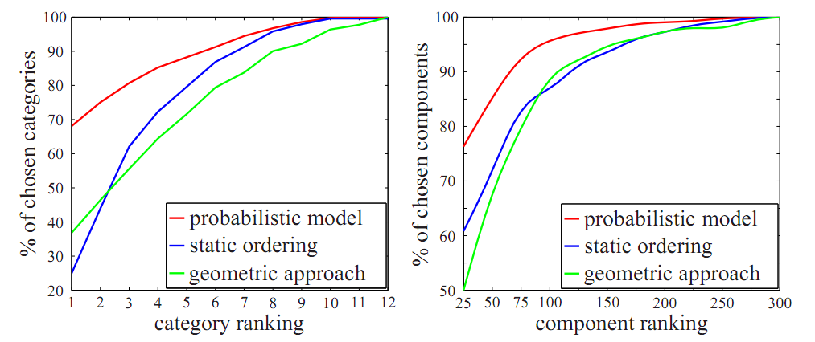
Relevance of suggested components – “Creatures” task
68%
37%
25%
Notes:
In this figure, we measure how frequently a chosen category appeared in the first positions of the ranked lists produced by each algorithm in the creatures task. The y-axis show the cumulative frequency of categories from which components were selected and the x-axis shows the category ranking at the time of selection. The performance of our probabilistic model is reflected on the red curve, the static condition on the blue curve and the approach of Chaudhuri and Koltun on the green curve. [CLICK] About 68% of the chosen components were selected from the category that was ranked first in the probabilistic model condition, compared to 37% in the approach of Chaudhuri and Koltun and 25% in the static condition. Therefore, more frequently selected categories usually appear ﬁrst in our probabilistic model, in contrast to the alternative methods. [CLICK]
This figure presents how frequently a chosen component appeared in the first positions of the ranked list of its category produced by each algorithm. Again, the relevance of components suggested based on probabilistic model was higher than the one based on the static ordering and the geometric approach. [NEXT]

Slide 43
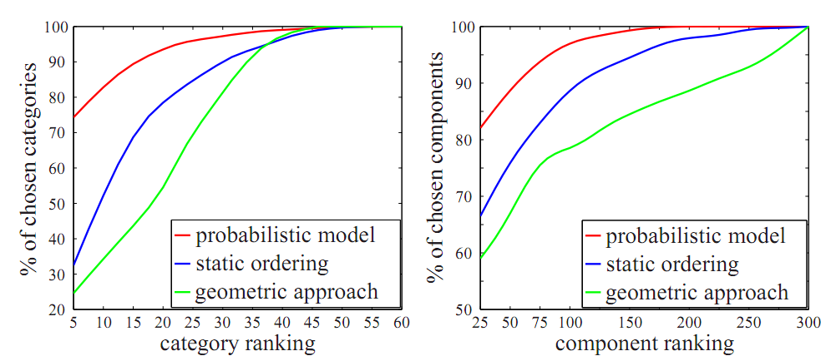
Relevance of suggested components – “Toy” task
Notes:
We saw the same behavior also in the Toy task. For both cases, the probabilistic model outperformed the static ordering and the geometric approach. [NEXT]

Slide 44
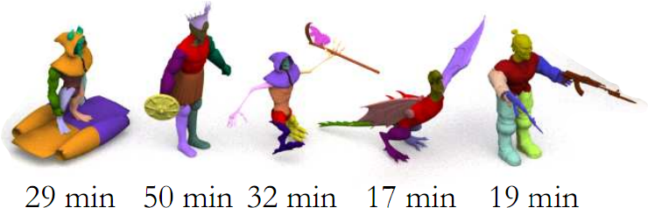
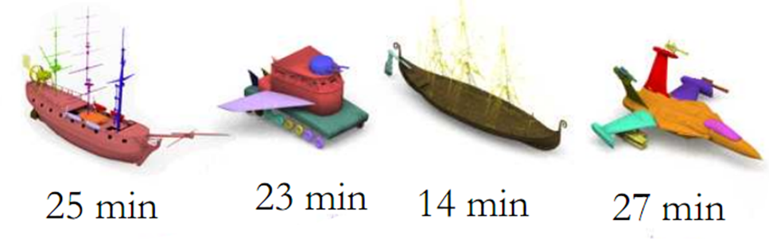
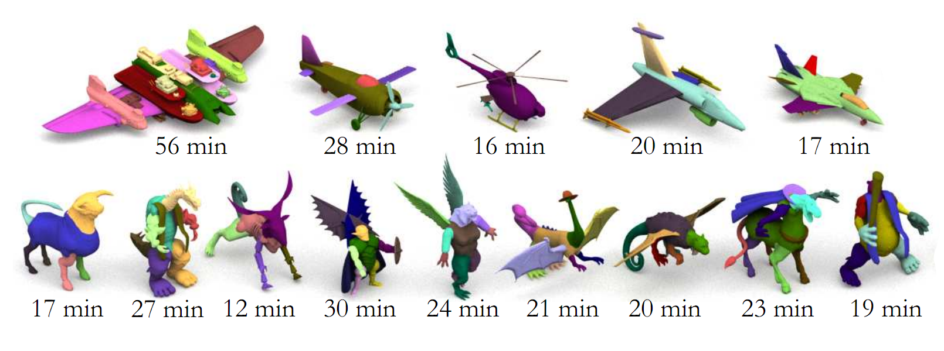
Examples of shapes created by users
Notes:
More specifically, here, I show the modeling session durations for representative shapes created by the users in the probabilistic model condition. The average modeling time per session with the probabilistic model was 21 minutes, while the average modeling time was 25 minutes with the static ordering and 34 minutes with the approach of Chaudhuri and Koltun. [NEXT]

Slide 45
Summary
Probabilistic reasoning for presenting components in assembly-based 3D modeling
Probabilistic graphical model for encoding conditional dependencies between shape components
Increases the relevance of suggested components
Notes:
I described a probabilistic reasoning approach to the presentation of components in open-ended, assembly-based 3D modeling. [CLICK] Our approach learns a probabilistic graphical model that encodes conditional dependencies between shape components. The model operates on both semantics and geometric style of components. During interactive modeling sessions, inference in the probabilistic model is used to present relevant components. [CLICK] Our experiments indicate that the probabilistic model increases the relevance of presented components. [NEXT]

Slide 46
Future Work
Better modeling of stylistic, spatial and functional relationships
Benefits from advances in:
  consistent shape segmentation
  gluing and cutting components
  editing geometry of individual components
Notes:
As future work, our model can be augmented to support better stylistic as well as spatial and functional relationships between components. [CLICK] The preprocessing stage our method can be further automated from developments in consistent shape segmentation. Our modeling interface can also benefit from advances in gluing and cutting components, [CLICK] as well as from integration with sketch-based interfaces for manipulating detailed geometry. [NEXT]

Slide 47


Thank you!
Acknowledgements: Aaron Hertzmann, Sergey Levine, Suchi Saria,
Jonathan Laserson, Philipp Krähenbühl, Daphne Koller,
Chris Platz, Hadidjah Chamberlin, Niels Joubert
Our project web page:
http://graphics.stanford.edu/~sidch/projects/assembly/
Notes:
Thank you!

Slide 49
BACKUP/OTHER SLIDES

Slide 50
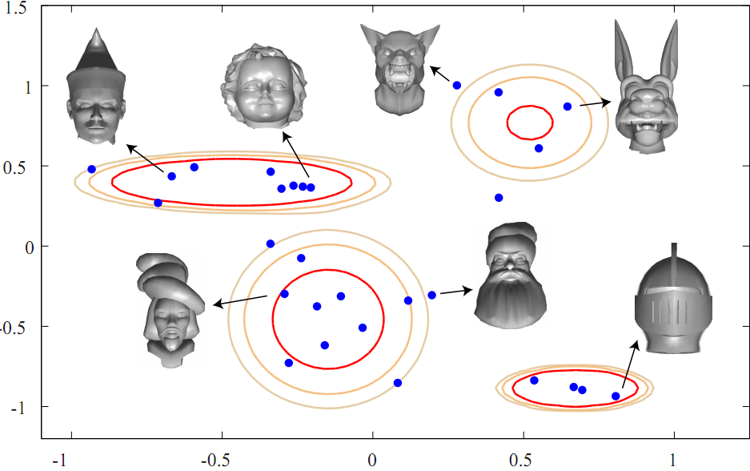
Gaussian mixture model for style clustering
Component features:
Shape diameter
Curvature
Singular values from PCA
Average geodesic distance
Geodesic distance from
other components
Notes:
More specifically, for each component, we extract a geometric feature vector which incorporates shape diameter, curvature, PCA descriptors, and geodesic distance-based descriptors. [CLICK] Then our algorithm performs clustering based on a Gaussian mixture model in this feature space. The mixture is a superposition of Gaussian distributions that have their own covariance structure. Each Gaussian is mapped to a cluster of geometrically similar components. In this example, we see four clusters representing four different styles of heads. [NEXT]

Slide 51
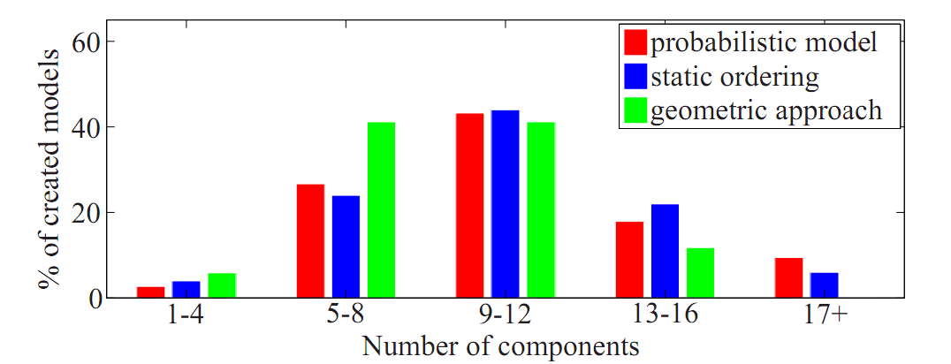
Number of components used per shape
Notes:
This Figure shows the distribution of the number of components used by participants in their models. Again, the red bars correspond to our probabilistic model, the blue bars to the static condition and the green bars to the approach of Chaudhuri and Koltun. On average, participants used 9.9 components for 3D models created with the probabilistic model.

Slide 52
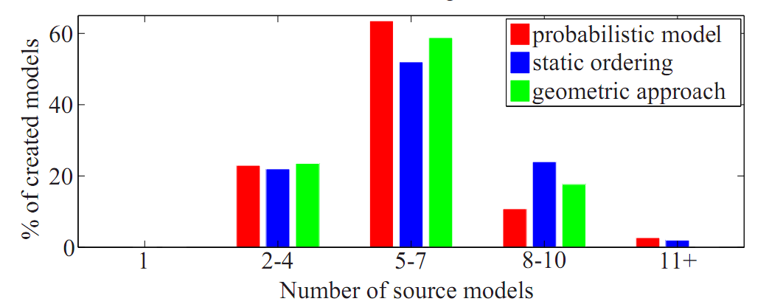
Number of source models contributing to each shape
Notes:
This Figure shows the distribution of the number of library models that served as sources of components for each assembled 3D model. On average in the probabilistic model condition, the components used in single assembled model originate from 5.7 library models. The average number of components per assembled model and the average number of source library models per assembled model was similar across the three conditions.

Slide 53
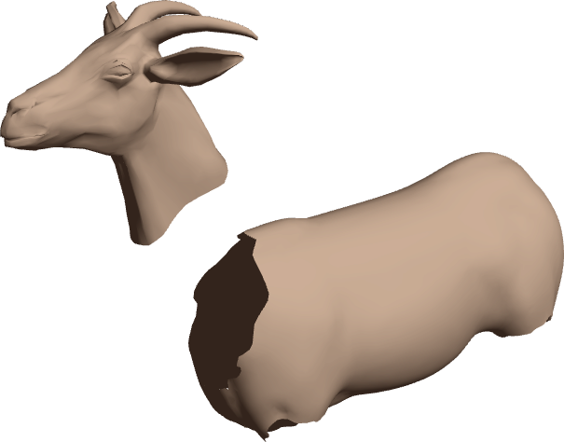
Component Assembly
Head
Torso

Slide 54
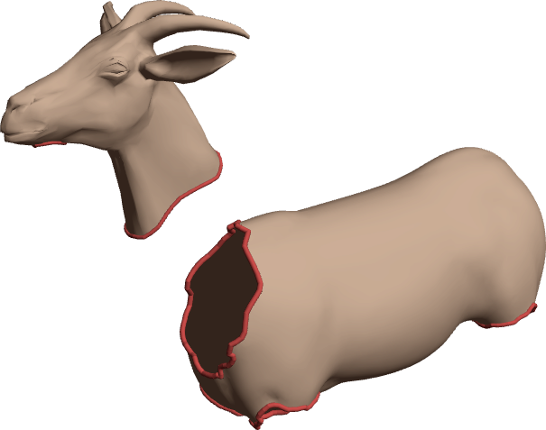
Component Assembly
Slots
Edge loops
Boundary vertices
Zones

Slide 55
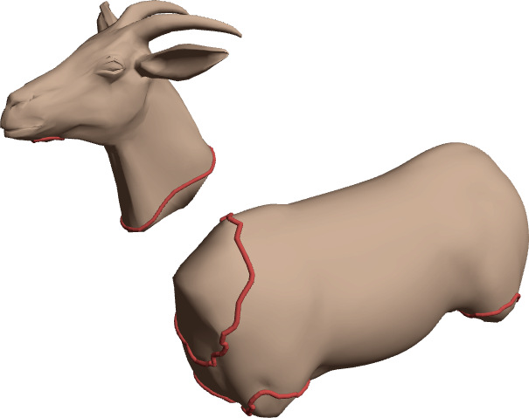
Component Assembly
Cap
[Schmidt/Singh '10]

Slide 56
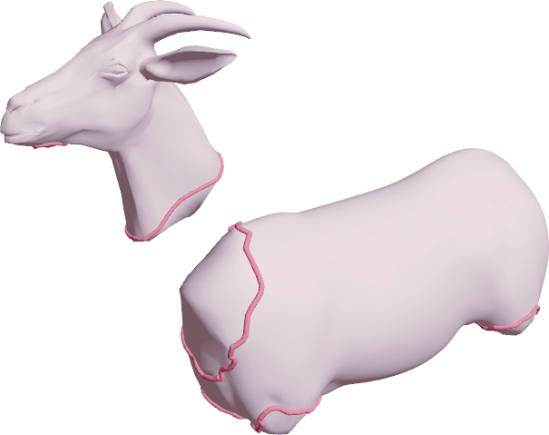
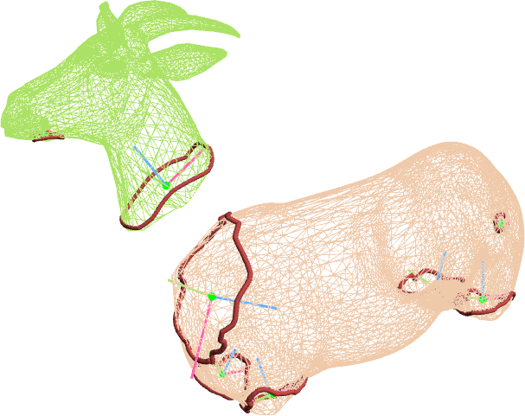
Component Assembly
Slot frames

Slide 57
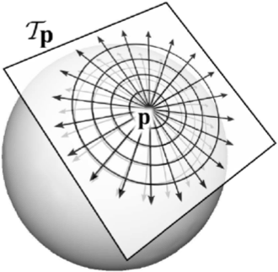
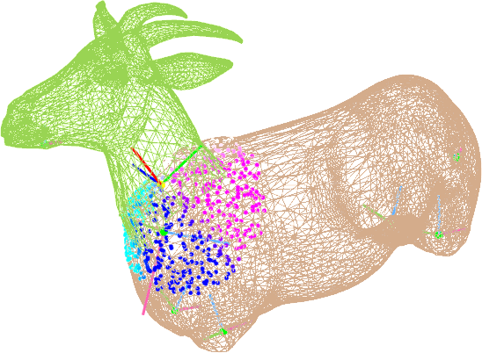
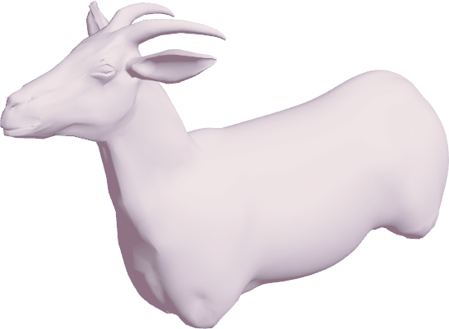
Component Assembly
Register Discrete
Exponential Maps
[Schmidt et al. '06, '10]
and deform proximal
regions for smooth join
(note: gluing is asymmetric, not slot-to-slot)

Slide 58
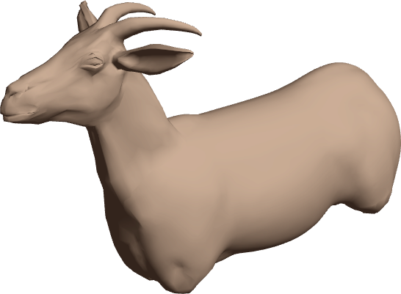
Component Assembly

Slide 59
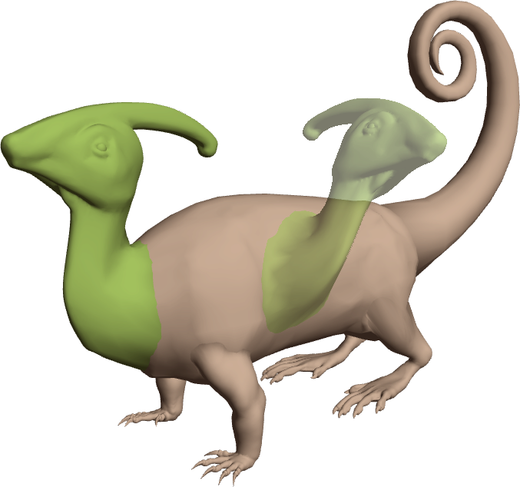
Constrained Translation
Incremental tangential motion following mouse drag
“Steps over” small surface detail

Slide 60
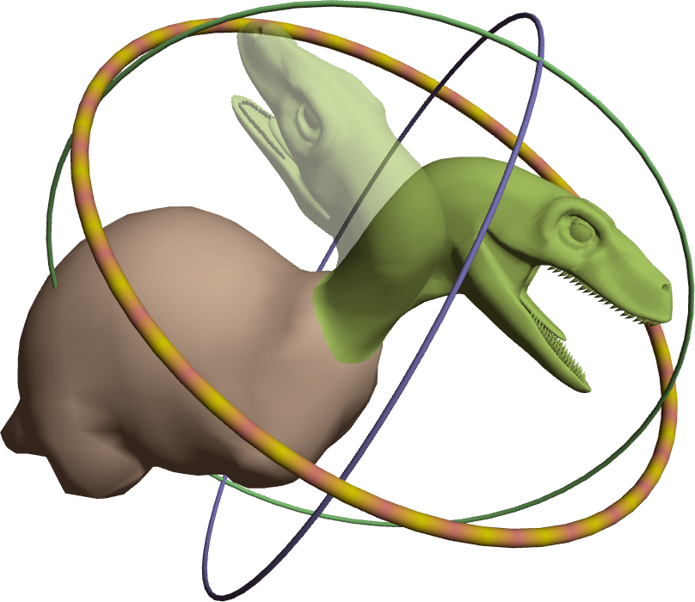
Constrained Rotation
1-DOF rotation in plane of attachment (selected above)
2-DOF rotation for tilt

Slide 61
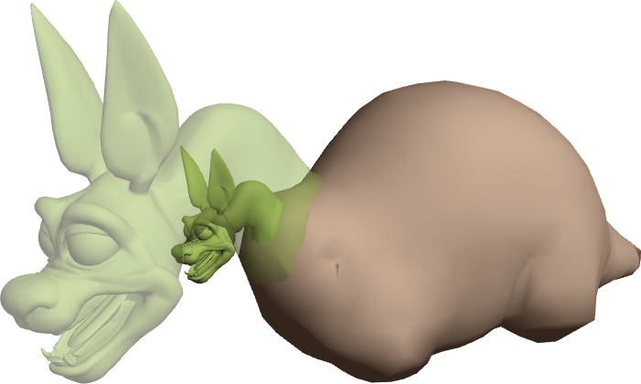
Constrained Scaling
Maintain point(s) of attachment

Slide 62
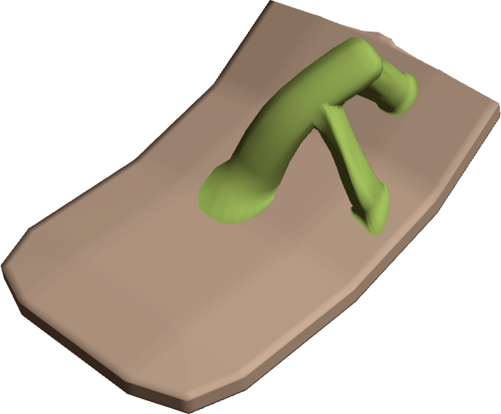
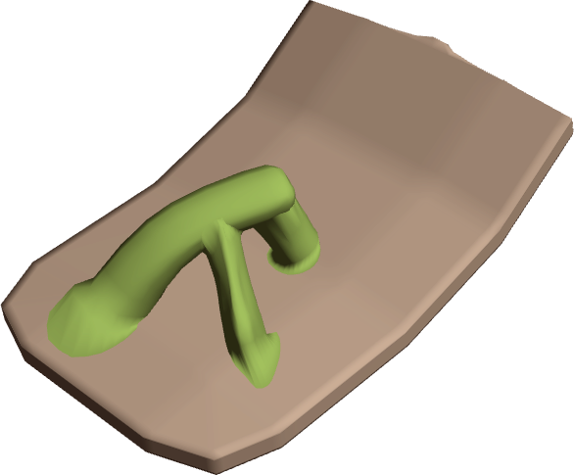
Multiple Constraints
Slide each attached slot individually
Overall motion computed from slot displacements
Motion prevented if not possible without breaking attachments

Slide 63
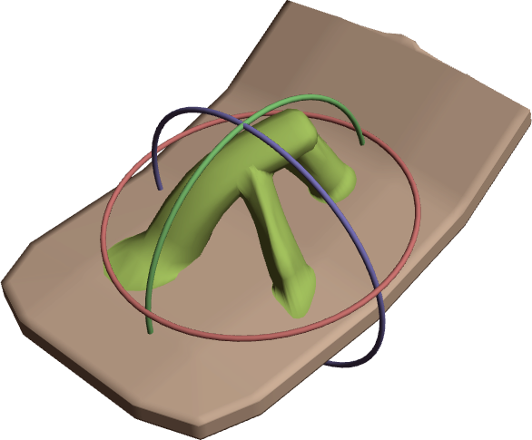

Multiple Constraints
Rotation axis computed from all current attachments
Rotation prevented if not possible without breaking attachments

Slide 64


Multiple Constraints
Multi-select
Scaling pivot computed from all current attachments
Scaling prevented if not possible without breaking attachments

Slide 65

Symmetry
Two wings created, since
max_{l'} P(R_{l,l'} | e) > 0
Symmetry plane of torso
automatically selected for wings
Query Bayesian Network for arg max_{l'} P(R_{l,l'} | e)
l is label of selected part, l' is label of another part in the assembly

Slide 66


Initial Adjacency
Legs snap to torso...
… but horns snap to head
Query Bayesian Network for arg max_{l'} P(A_{l,l'} | e)
l is label of selected part, l' is label of another part in the assembly

Slide 67

Modeling Interface
Modeling
Area

